Slide 2
Overview
Policy engagement
The APPG for AT
Accessible VLEs
The Working Group
Focus on VLEs
Statement
Requirement

Slide 3
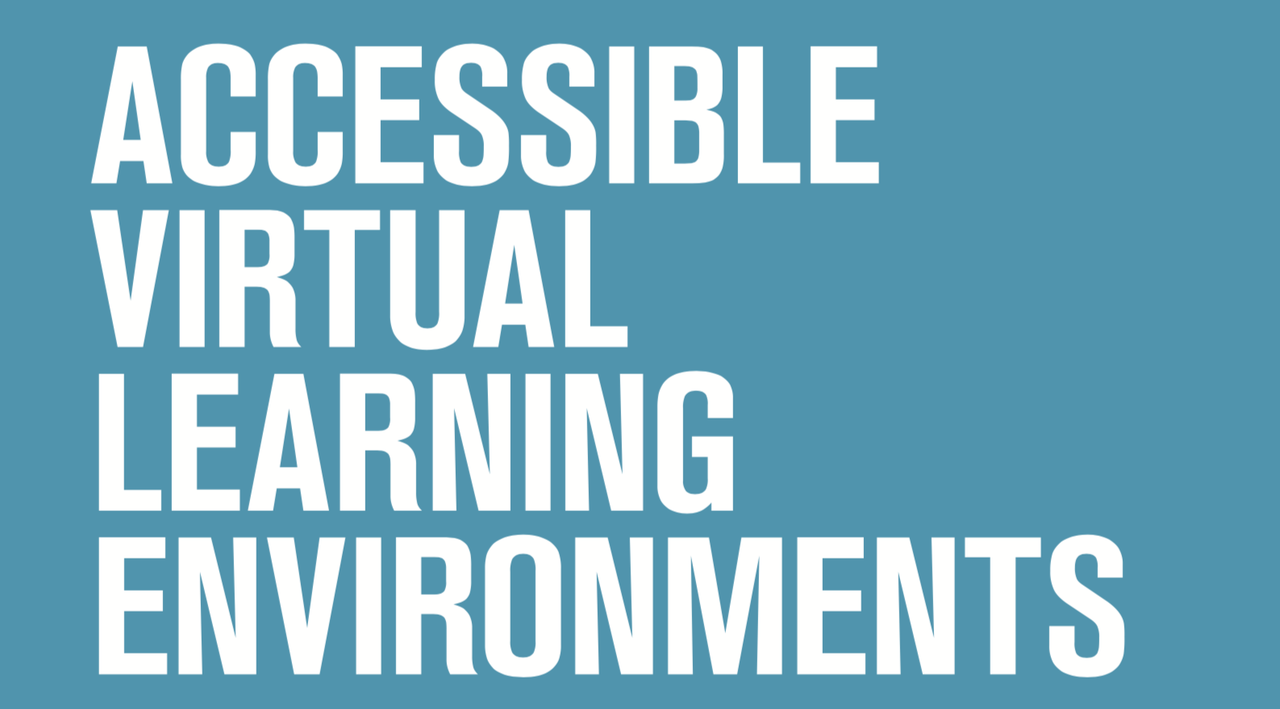
Policy Engagement
The APPG for AT
Accessible VLEs
Parliament
Government
HEIs
Working Group
Sector expertise
GDS

Slide 4
Next steps for Policy Engagement
Further Guidance
Working Group
GDS
EHRC
Support for the sector
Communication to leaders
Involvement of Office for Students

Slide 5
Focus on VLEs [this is not legal advice]
In what circumstances is content on older VLEs exempt?
Directive
Legislation
Guidance
When are old VLEs new again?
Accumulation of incremental changes
From when?

Slide 6
Exemption for some content on older VLEs
Directive
This Directive does not apply to the following content of websites and mobile applications: …content of extranets and intranets, that is to say, websites that are only available for a closed group of people and not to the general public as such, published before 23 September 2019, until such websites undergo a substantial revision
Legislation
These Regulations do not apply to the following content of a website or mobile application of a public sector body—… content of extranets and intranets published before 23rd September 2019, until such websites undergo a substantial revision
Guidance
Things you might not need to fix:… content on intranets or extranets published before September 2019 (unless you make a major revision after that date)”

Slide 7
Exemption for some content on older VLEs
Directive
This Directive does not apply to the following content of websites and mobile applications: …content of extranets and intranets, that is to say, websites that are only available for a closed group of people and not to the general public as such, published before 23 September 2019, until such websites undergo a substantial revision
Legislation
These Regulations do not apply to the following content of a website or mobile application of a public sector body—… content of extranets and intranets published before 23rd September 2019, until such websites undergo a substantial revision
Guidance
Things you might not need to fix:… content on intranets or extranets published before September 2019 (unless you make a major revision after that date)

Slide 8
Substantial revision – what counts
Because VLE content is regularly and frequently updated and changed, the accumulation of these incremental changes means that could add up to substantial revision, e.g. once per academic year.
Cf. GDS guidance “Example: Every academic year, some of your content is updated as course requirements change. If it’s not due for an update, you might be able to say that making it accessible is a disproportionate burden because you can only afford to update it once a year. When it’s time to update the content anyway, you’re less likely to be able to argue that it’s a disproportionate burden”.

Slide 9
Substantial revision – when does the clock start?
Theory one: from 2018, i.e. when the law started
- so new again in 2019
Theory two: from 2019, i.e. “after that date”
- so new again in 2020

Slide 10
Get involved
FE/HE Working Group
jisc.ac.uk/accessibility
DIGITALACCESSIBILITYREGULATIONS [at] @JISCMAIL.AC.UK
The APPG for Assistive Technology
policyconnect.org.uk/appgat/newsletter-signup
@AT_APPG - #AccessableVLEs
Robert.mclaren@policyconnect.org.uk

